Slide 1
Date
PRESENTED BY:
November 1, 2022
Christian Rhomel Aguila
Cyclistic: Difference of Annual Members and Casual Riders

Slide 2
Agenda
Page
I
Objective
3
II
Data and Analysis
4
III
Summary of findings
14
IV
Recommendations
16

Slide 3
Objective
Determine the difference between annual members and casual riders to form a marketing strategy aimed at converting casual riders to annual members.
3

Slide 4
Data and Analysis
The analysis is performed using the historical data of Cyclistic bike share company based in Chicago. The data is used to identify trends and get insights to make informed decisions for the company.
4

Slide 5
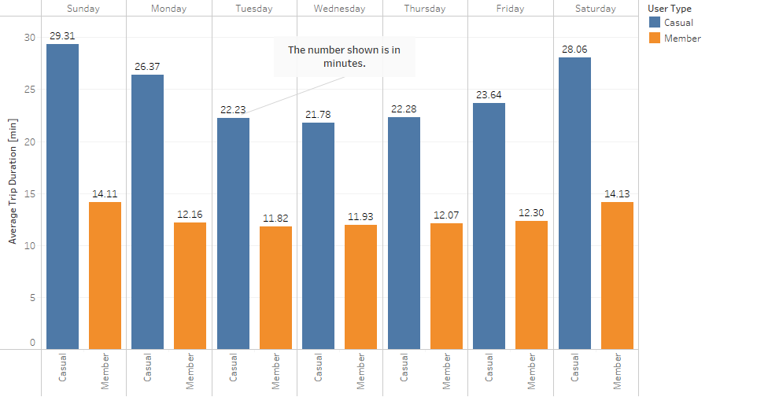
Average Trip Duration of Casual Riders and Annual Members
The chart shows the average trip duration of bike users for each day in a week.
Trip duration is measured in minutes.
5

Slide 6
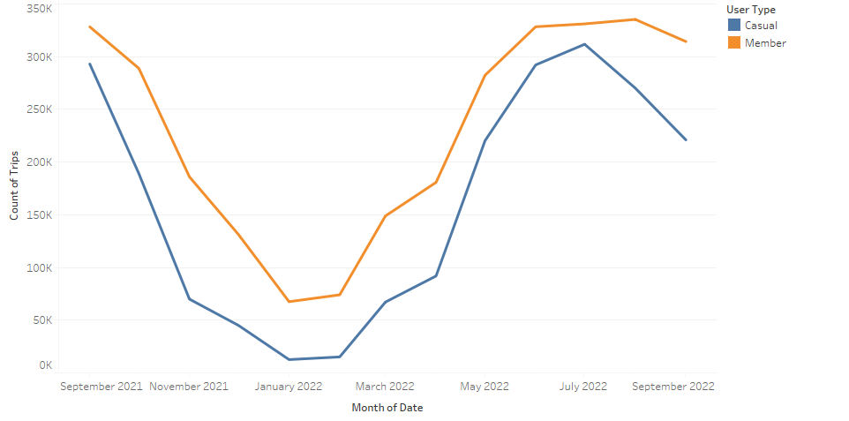
Count of Trips of Annual Members and Casual Riders
The chart shows the trip counts of bike users from Sep. 2021 to Sep. 2022.
Months December, January, and February has the least number of rides.
Months June, July, and August has the most number of rides ..
6

Slide 7
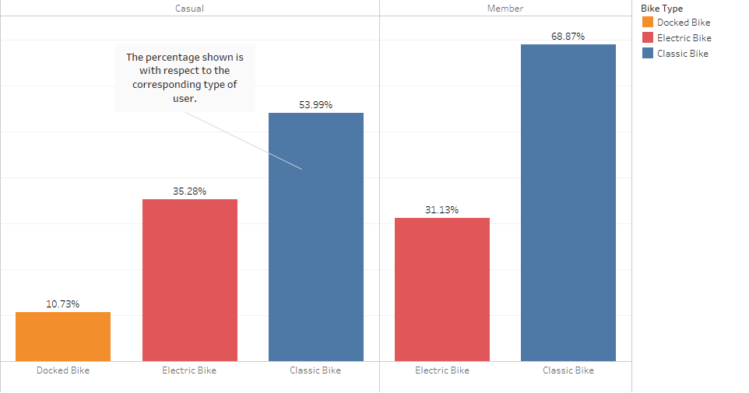
Most Preferred Bike Type of Cylistic Users
Both annual members and casual riders prefer to use classic bikes.
Annual members prefer not to use docked bikes while casual member use them.
Data is from Sep. 2021 to Sep. 2022.
7

Slide 8
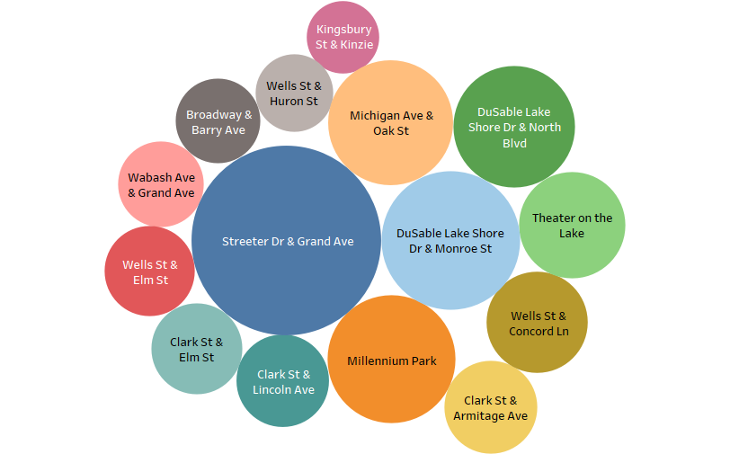
Top 15 Start Station for Casual Riders
The stations showed are top start stations for casual riders.
The larger the circle, the higher the number of trips that started from that station.
8

Slide 9
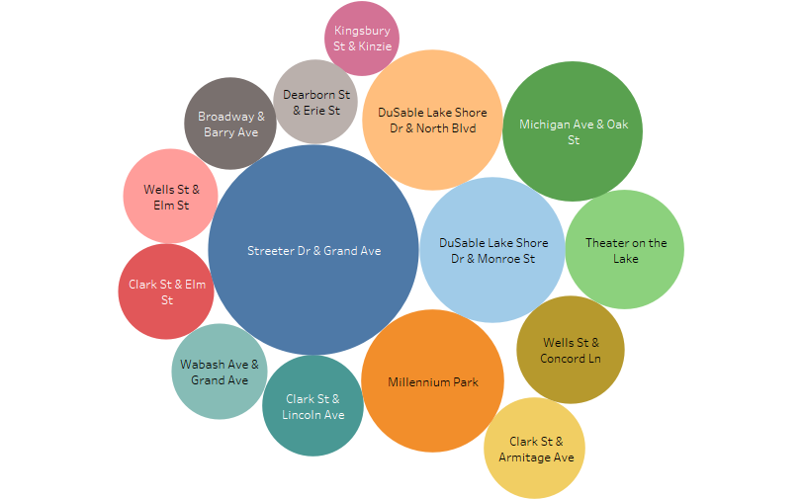
Top 15 End Station for Casual Riders
The stations showed are top end stations for casual riders.
The larger the circle, the higher the number of trips that ended to that station.
9

Slide 10
Digging deeper into the historical data
Plenty of Cyclistic bike users have the same start station and end station. It might be helpful to see if there are some essential information that can be helpful in finding the difference between the two types of user.
10

Slide 11
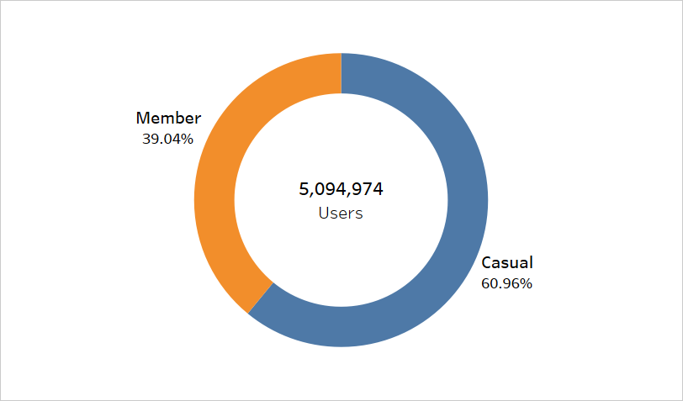
Distribution of Users that Start and End with the Same Station
Casual riders tend to have more circular rides (same start and end station) than members.
11

Slide 12
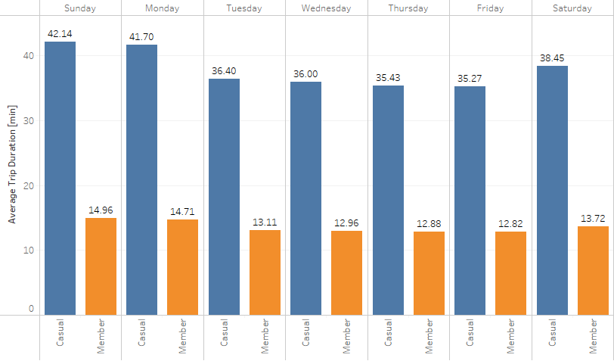
Circular Rides: Average Trip Duration of Casual Riders and Annual Members
Average trip duration in each day of the week for circular rides.
Casual riders tend to have longer trip duration than annual members.
Trip duration is measured in minutes.
12

Slide 13
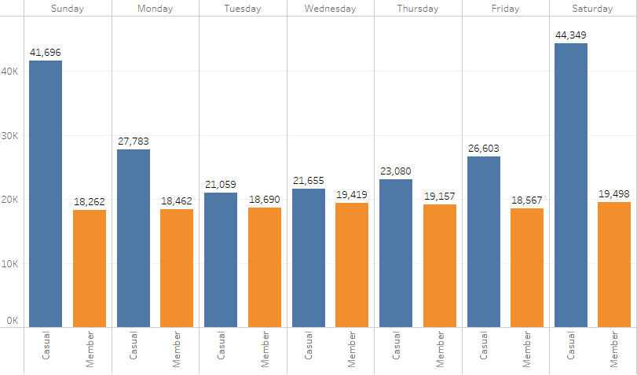
Circular Rides: Trips Counts of Annual Members and Casual Riders
Casual riders tend to ride more during weekends (Saturday and Sunday)
13

Slide 14
Summary of Findings
Casual riders tend to have longer trip duration than annual members having maximum average ride length of roughly 29.31 minutes. They also tend to have more trips during Saturday and Sunday.
The trip counts started to decline in month of September approaching winter season where both user types have the lowest trip counts in January.
The trip counts started to rise in month of March approaching summer season where members and casual riders have the highest trip counts in August and July respectively.
14

Slide 15
Summary of Findings
Annual members prefer not to use docked bikes while casual member use them.
Streeter Dr & Grand Ave and DuSable Lake Shore Dr & Monroe St are both the top start and end stations for casual riders.
Majority of users that start and end with the same station are casual riders having a percentage of 60.96%
15

Slide 16
Recommendations
Create and improve marketing campaign that is targeted at top stations for casual riders.
Have digital campaign which includes sending email or texting users about discounts in service fee for being annual member
Offer specialized benefits at weekend trips if user purchase annual membership.
Provide reservation priority to annual members such as bike type reservation, and time of ride so that members have less waiting time and can choose to use their preferred bike.
16

